Slide 1

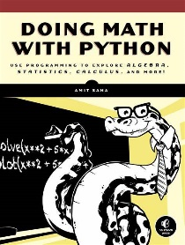

Doing Math with Python Opening and Intro
001
GitHub: https://github.com/yasenstar/DoingMathWithPython
Gitee: https://gitee.com/yasenstar/DoingMathWithPython
Yasen – Enterprise Architecture
YouTube: @yasenzhao

Slide 2
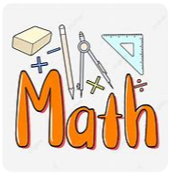
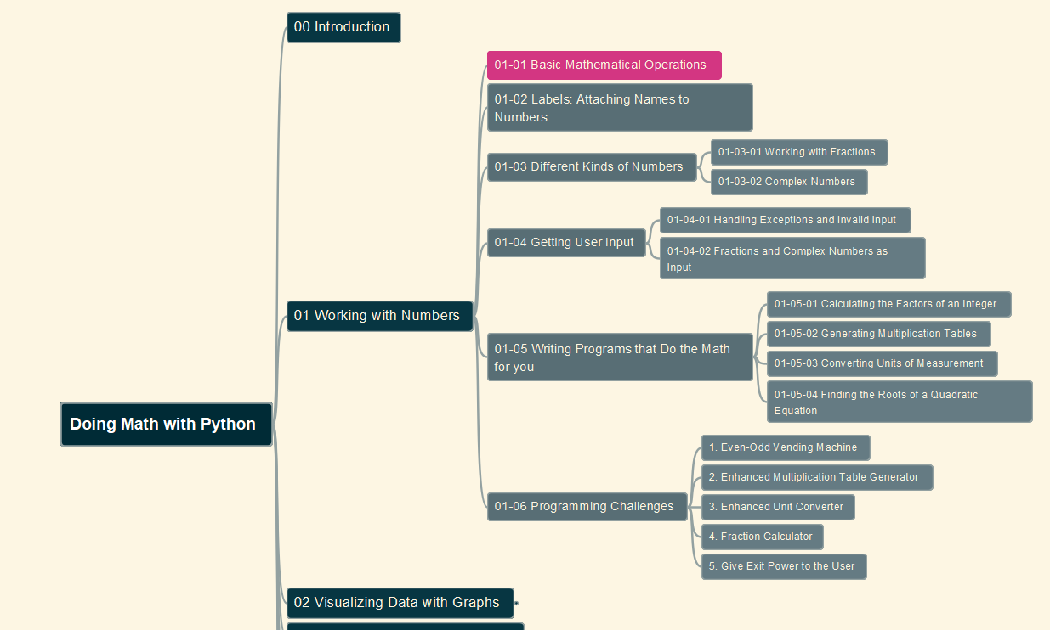
Doing Math with Python
002
Chapter 01: Working with Numbers
01-01 Basic Mathematical Operations
GitHub: https://github.com/yasenstar/DoingMathWithPython
Gitee: https://gitee.com/yasenstar/DoingMathWithPython
Yasen – Enterprise Architecture
YouTube: @yasenzhao

Slide 3
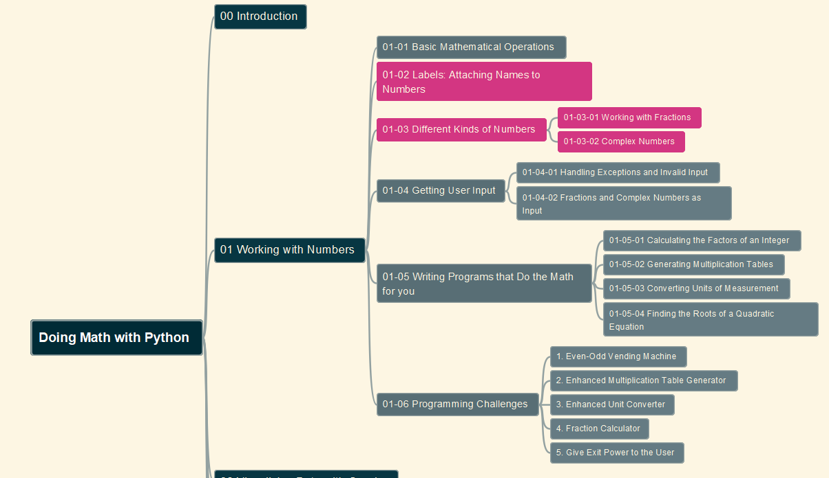
Doing Math with Python
003
Chapter 01: Working with Numbers
01-02 Labels: Attaching Names to Numbers
01-03 Different Kinds of Numbers
GitHub: https://github.com/yasenstar/DoingMathWithPython
Gitee: https://gitee.com/yasenstar/DoingMathWithPython
Yasen – Enterprise Architecture
YouTube: @yasenzhao

Slide 4
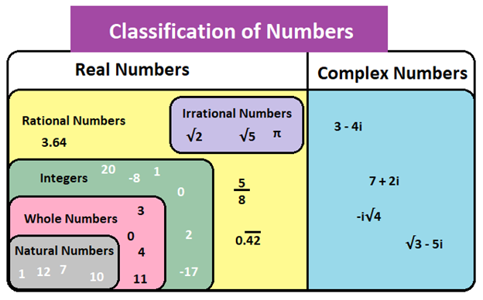
About Number’s Definition and Range

Slide 5
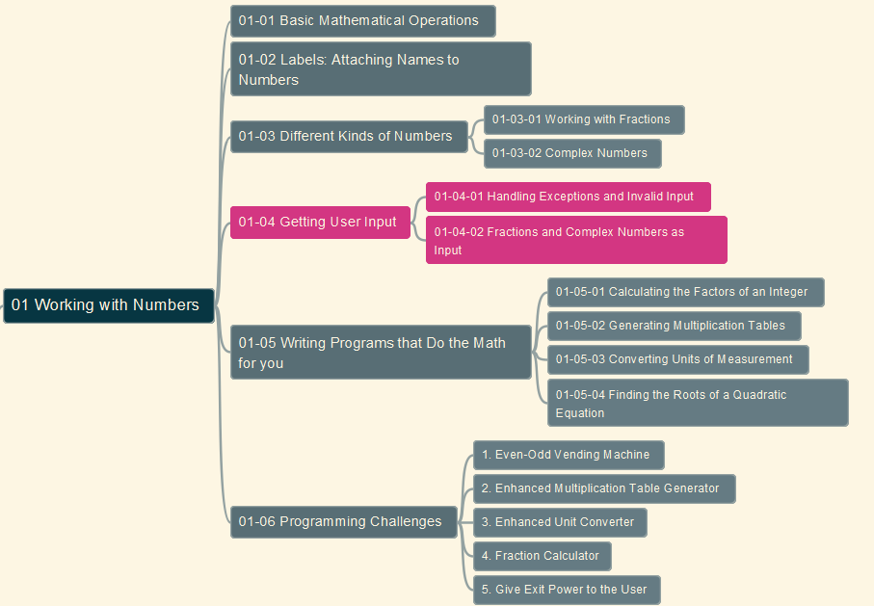
Doing Math with Python
004
Chapter 01: Working with Numbers
01-04 Getting User Input
GitHub: https://github.com/yasenstar/DoingMathWithPython
Gitee: https://gitee.com/yasenstar/DoingMathWithPython
Yasen – Enterprise Architecture
YouTube: @yasenzhao

Slide 6
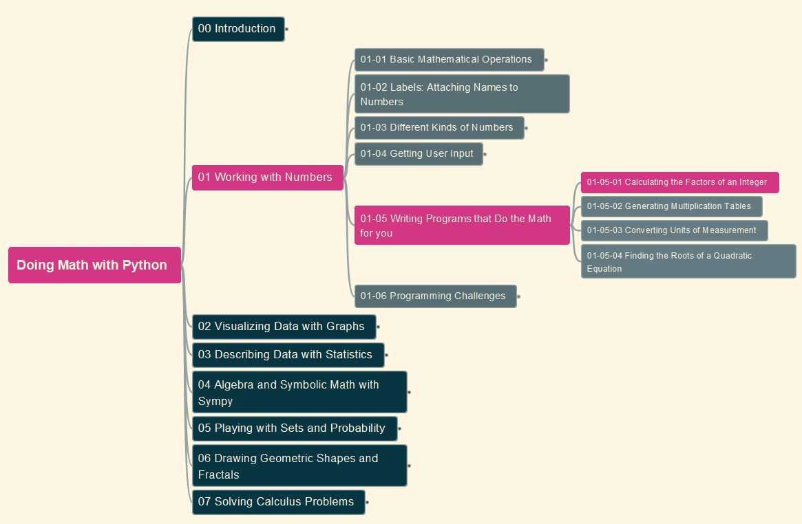
Doing Math with Python
005
Chapter 01: Working with Numbers
01-05 Writing Programs that Do the Math (1)
GitHub: https://github.com/yasenstar/DoingMathWithPython
Gitee: https://gitee.com/yasenstar/DoingMathWithPython
Yasen – Enterprise Architecture
YouTube: @yasenzhao

Slide 7

Doing Math with Python
006
Chapter 01: Working with Numbers
01-05 Writing Programs that Do the Math (2)
GitHub: https://github.com/yasenstar/DoingMathWithPython
Gitee: https://gitee.com/yasenstar/DoingMathWithPython
Yasen – Enterprise Architecture
YouTube: @yasenzhao

Slide 8
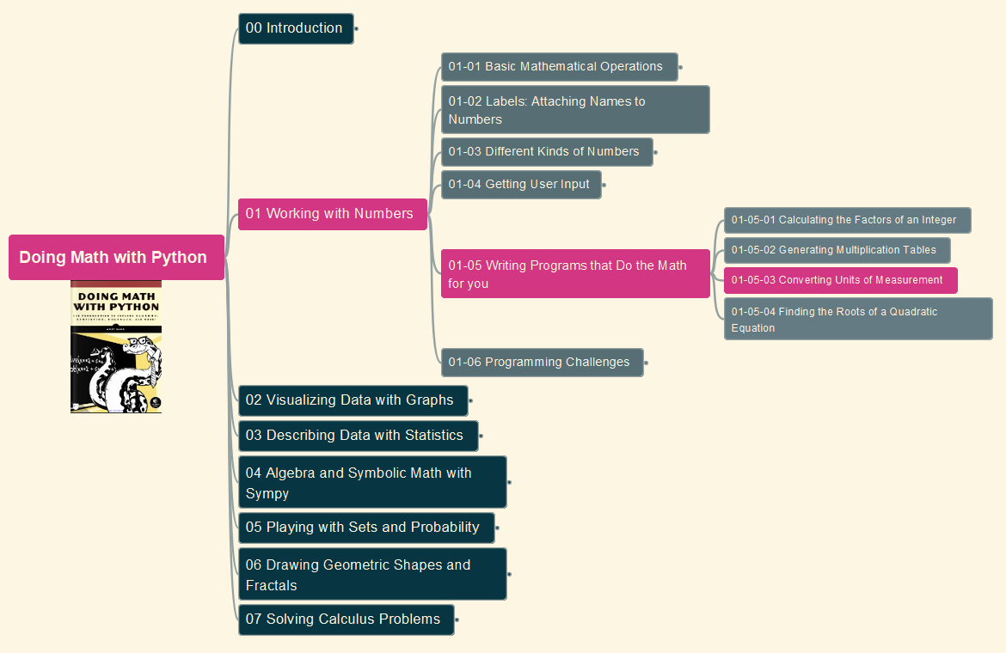
Doing Math with Python
007
Chapter 01: Working with Numbers
01-05 Writing Programs that Do the Math (3)
GitHub: https://github.com/yasenstar/DoingMathWithPython
Gitee: https://gitee.com/yasenstar/DoingMathWithPython
Yasen – Enterprise Architecture
YouTube: @yasenzhao

Slide 9
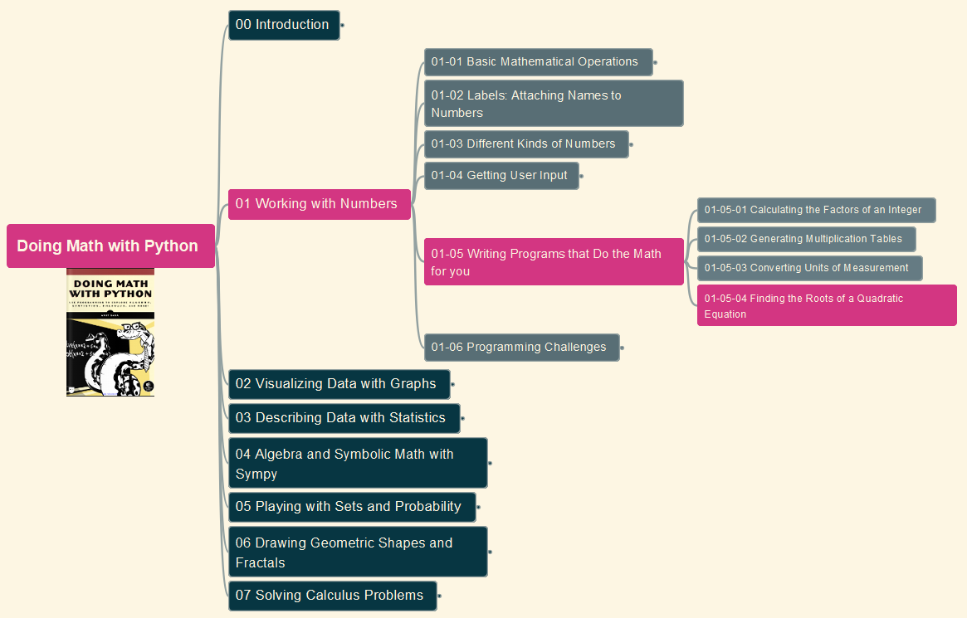
Doing Math with Python
008
Chapter 01: Working with Numbers
01-05 Writing Programs that Do the Math (4)
GitHub: https://github.com/yasenstar/DoingMathWithPython
Gitee: https://gitee.com/yasenstar/DoingMathWithPython
Yasen – Enterprise Architecture
YouTube: @yasenzhao

Slide 10
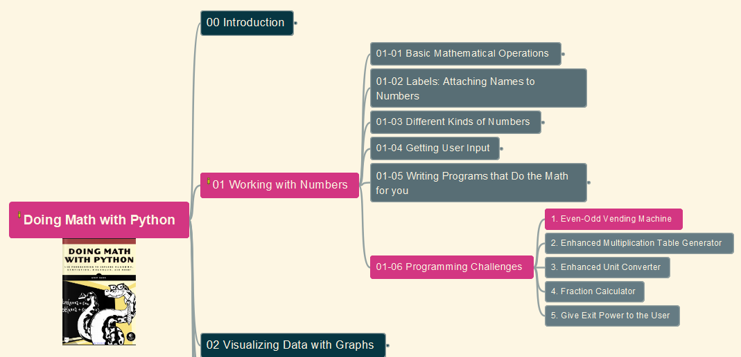
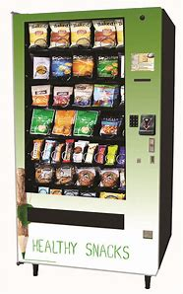
Doing Math with Python
009
Chapter 01: Working with Numbers
Challenges #1: Even-Odd Vending Machine
GitHub: https://github.com/yasenstar/DoingMathWithPython
Gitee: https://gitee.com/yasenstar/DoingMathWithPython
Yasen – Enterprise Architecture
YouTube: @yasenzhao

Slide 11
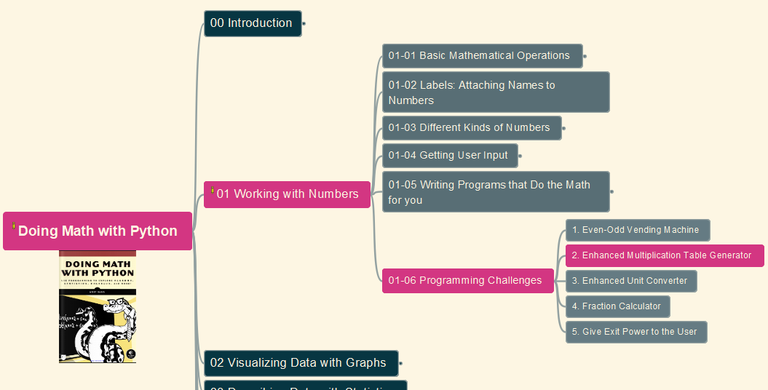

Doing Math with Python
010
Chapter 01: Working with Numbers
Challenges #2: Enhanced Multiplication Table Generator
GitHub: https://github.com/yasenstar/DoingMathWithPython
Gitee: https://gitee.com/yasenstar/DoingMathWithPython
Yasen – Enterprise Architecture
YouTube: @yasenzhao

Slide 12
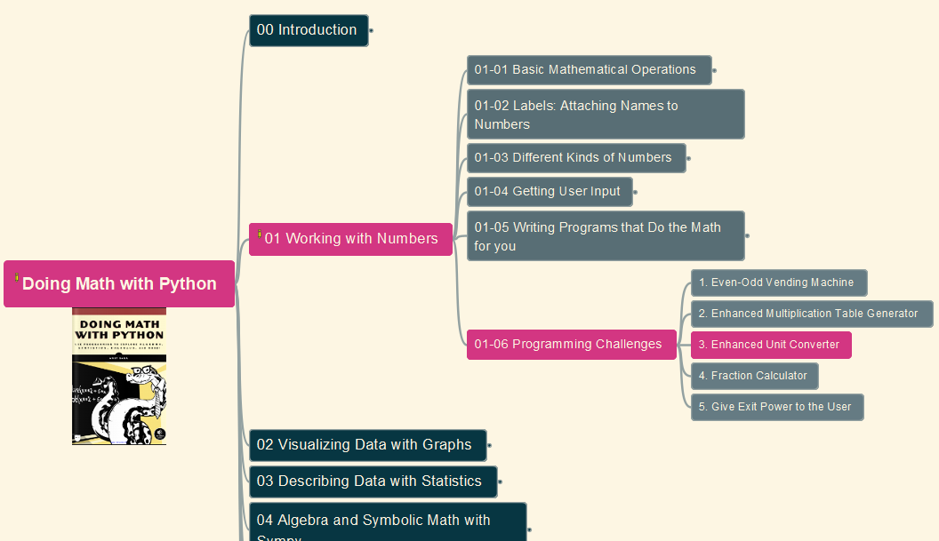

Doing Math with Python
011
Chapter 01: Working with Numbers
Challenges #3: Enhanced Unit Converter
GitHub: https://github.com/yasenstar/DoingMathWithPython
Gitee: https://gitee.com/yasenstar/DoingMathWithPython
Yasen – Enterprise Architecture
YouTube: @yasenzhao

Slide 13
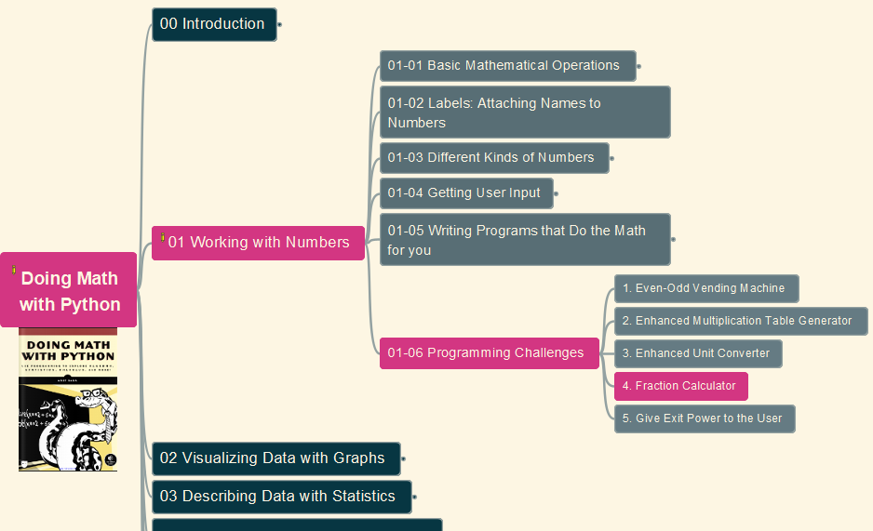
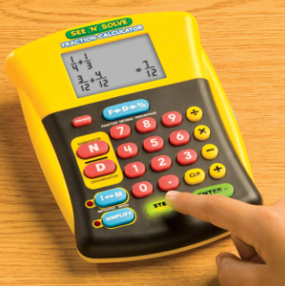
Doing Math with Python
012
Chapter 01: Working with Numbers
Challenges #4: Fraction Calculator
GitHub: https://github.com/yasenstar/DoingMathWithPython
Gitee: https://gitee.com/yasenstar/DoingMathWithPython
Yasen – Enterprise Architecture
YouTube: @yasenzhao

Slide 14
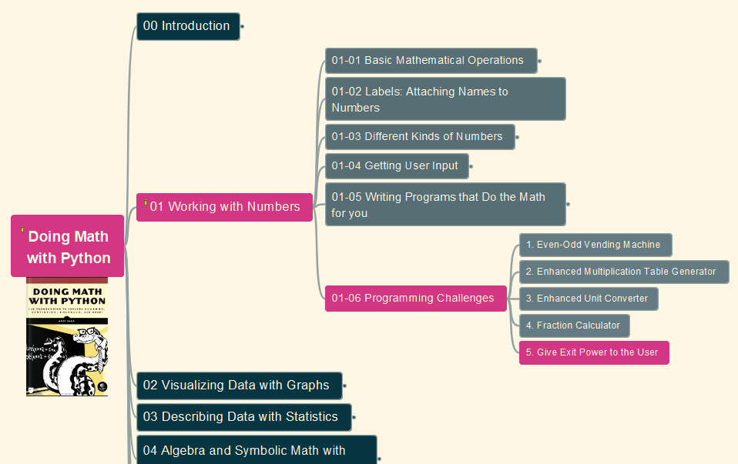

Doing Math with Python
013
Chapter 01: Working with Numbers
Challenges #5: Give Exit Power to the User
GitHub: https://github.com/yasenstar/DoingMathWithPython
Gitee: https://gitee.com/yasenstar/DoingMathWithPython
Yasen – Enterprise Architecture
YouTube: @yasenzhao

Slide 15
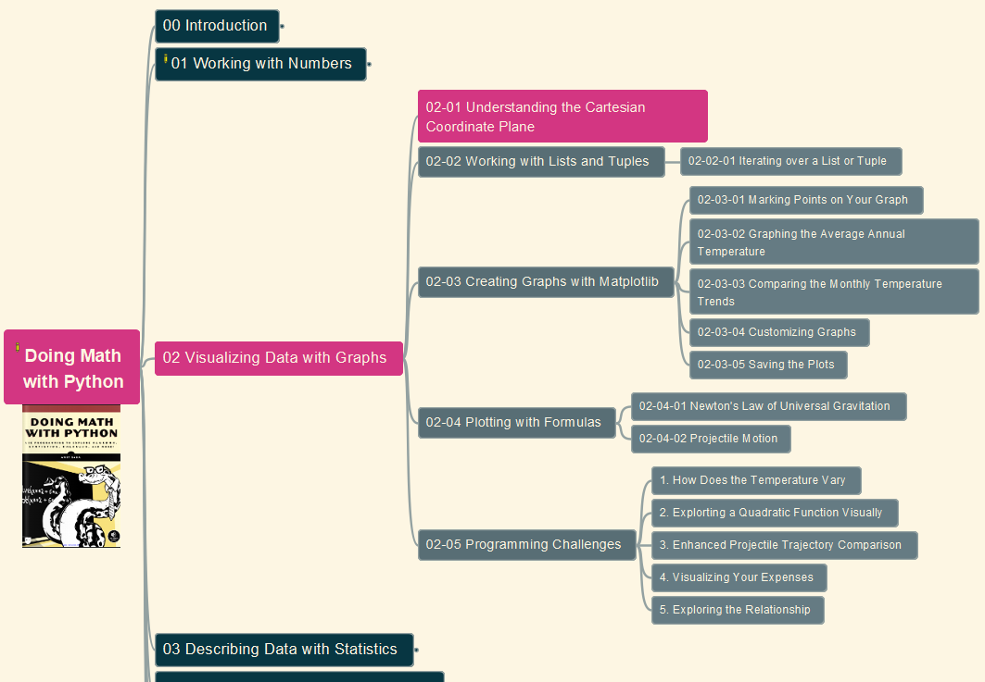
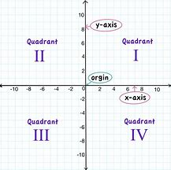
Doing Math with Python
014
Chapter 02: Visualizing Data with Graphs
02-01: Understanding the Cartesian Coordinate Plane
GitHub: https://github.com/yasenstar/DoingMathWithPython
Gitee: https://gitee.com/yasenstar/DoingMathWithPython
Yasen – Enterprise Architecture
YouTube: @yasenzhao

Slide 16
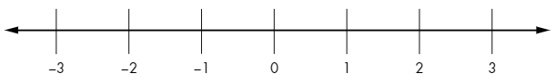
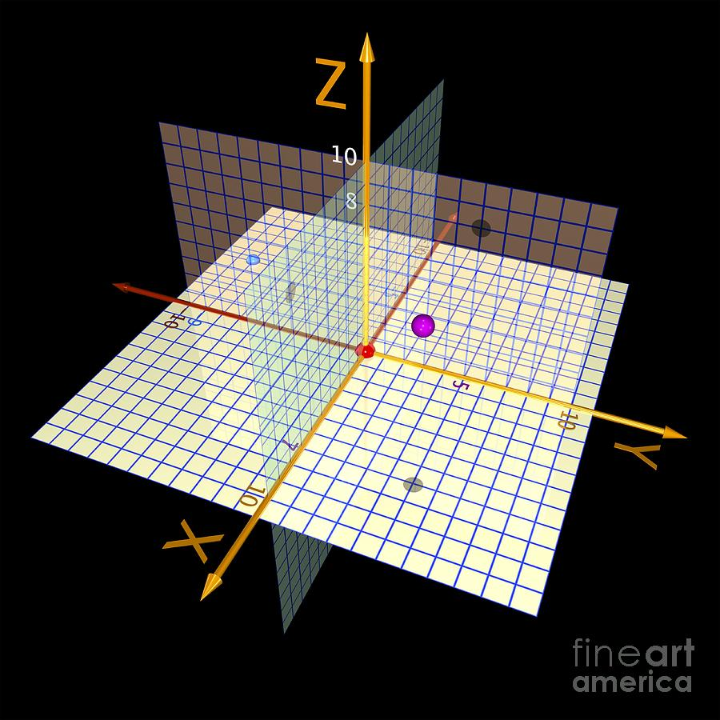
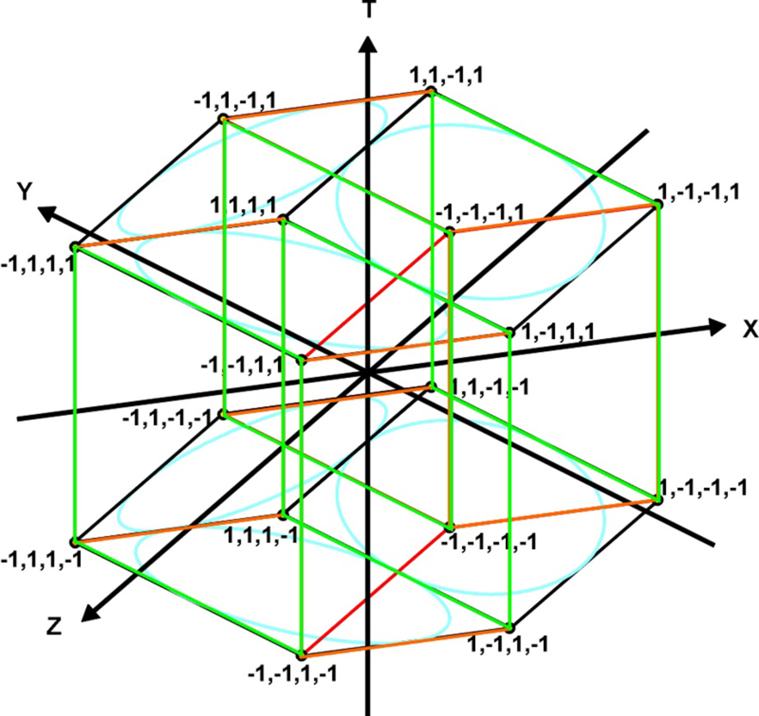
Cartesian Coordinates Plane
1 Dimension – number line
2 Dimensions
3 Dimensions
4 Dimensions

Slide 17
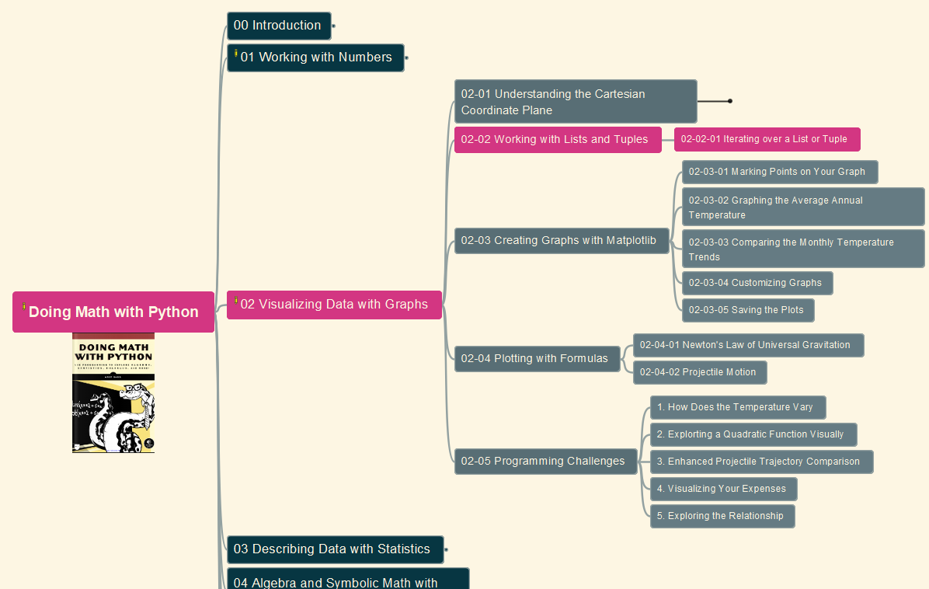
Doing Math with Python
015
Chapter 02: Visualizing Data with Graphs
02-02: Working with Lists and Tuples
GitHub: https://github.com/yasenstar/DoingMathWithPython
Gitee: https://gitee.com/yasenstar/DoingMathWithPython
Yasen – Enterprise Architecture
YouTube: @yasenzhao

Slide 18
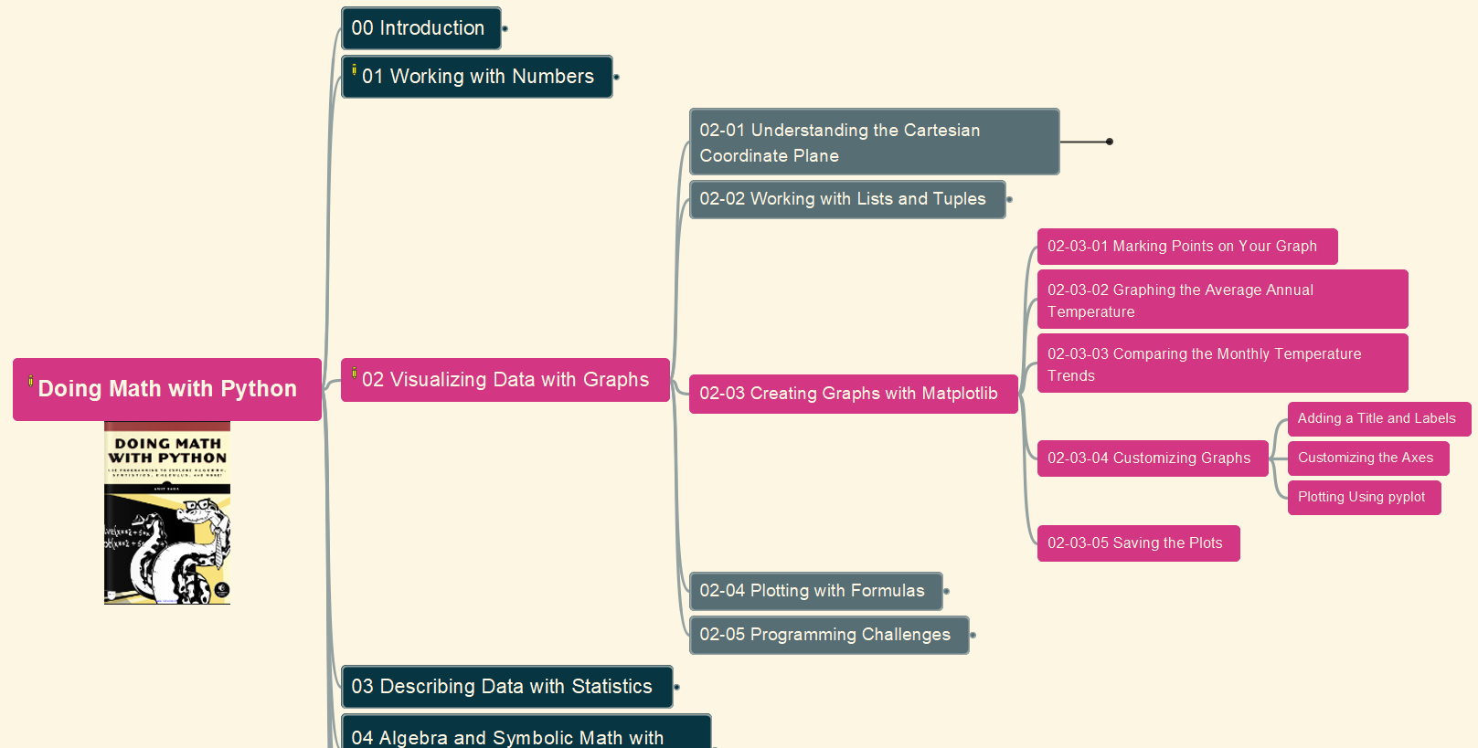
Doing Math with Python
016
Chapter 02: Visualizing Data with Graphs
02-03: Creating Graphs with Matplotlib (& pylab)
GitHub: https://github.com/yasenstar/DoingMathWithPython
Gitee: https://gitee.com/yasenstar/DoingMathWithPython
Yasen – Enterprise Architecture
YouTube: @yasenzhao

Slide 19
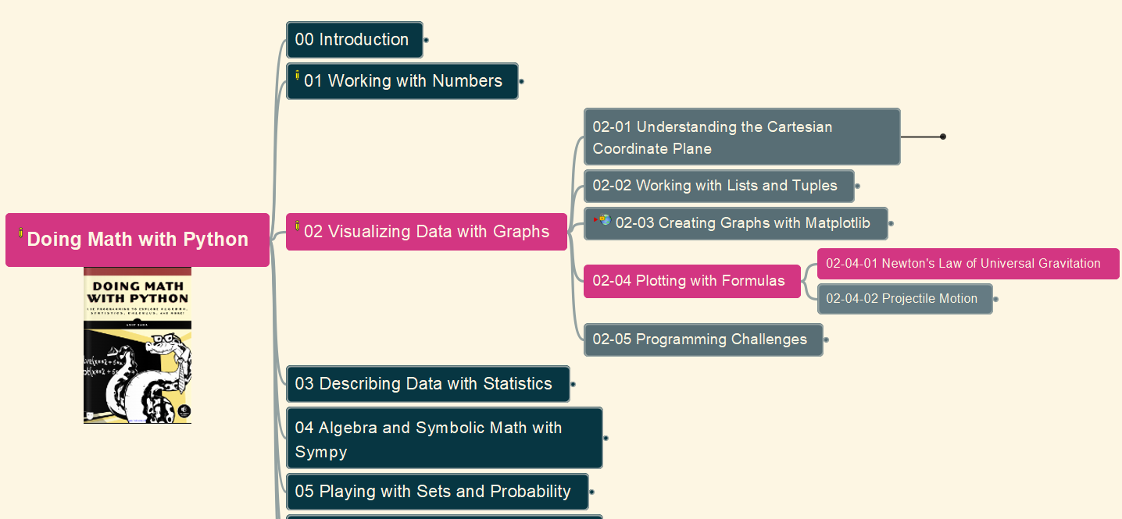
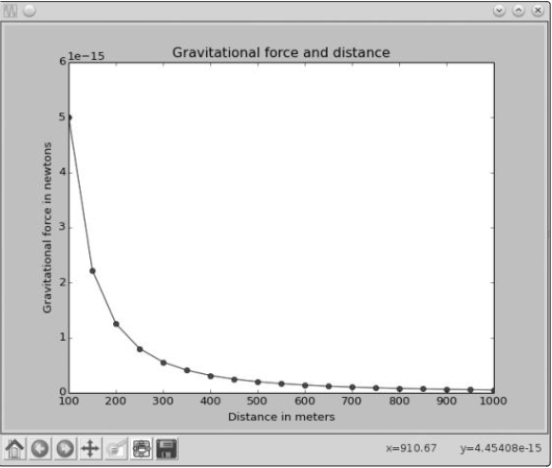
Doing Math with Python
017
Chapter 02: Visualizing Data with Graphs
02-04 (1): Newtons Law of Universal Gravitation
GitHub: https://github.com/yasenstar/DoingMathWithPython
Gitee: https://gitee.com/yasenstar/DoingMathWithPython
Yasen – Enterprise Architecture
YouTube: @yasenzhao

Slide 20
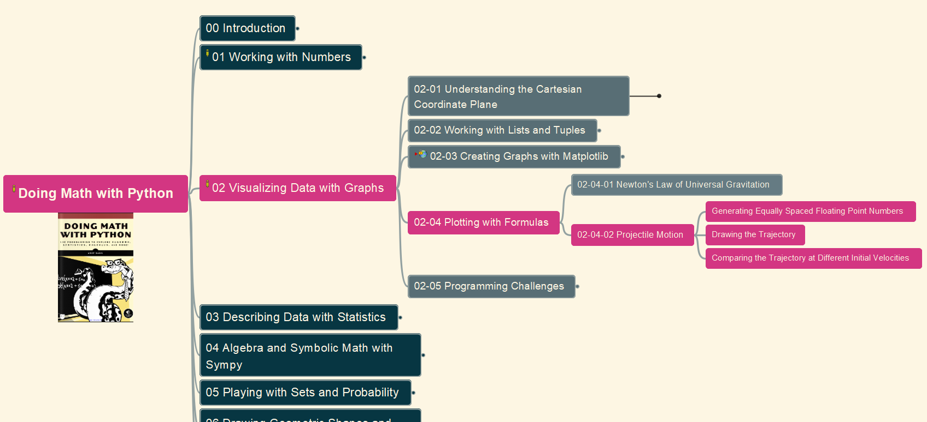
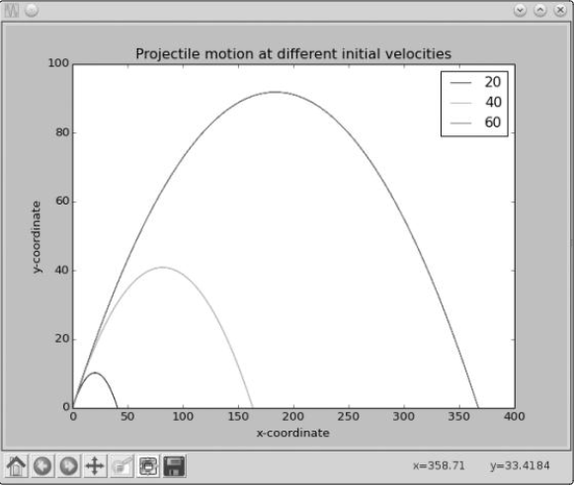
Doing Math with Python
018
Chapter 02: Visualizing Data with Graphs
02-04 (2): Projectile Motion
GitHub: https://github.com/yasenstar/DoingMathWithPython
Gitee: https://gitee.com/yasenstar/DoingMathWithPython
Yasen – Enterprise Architecture
YouTube: @yasenzhao

Slide 21
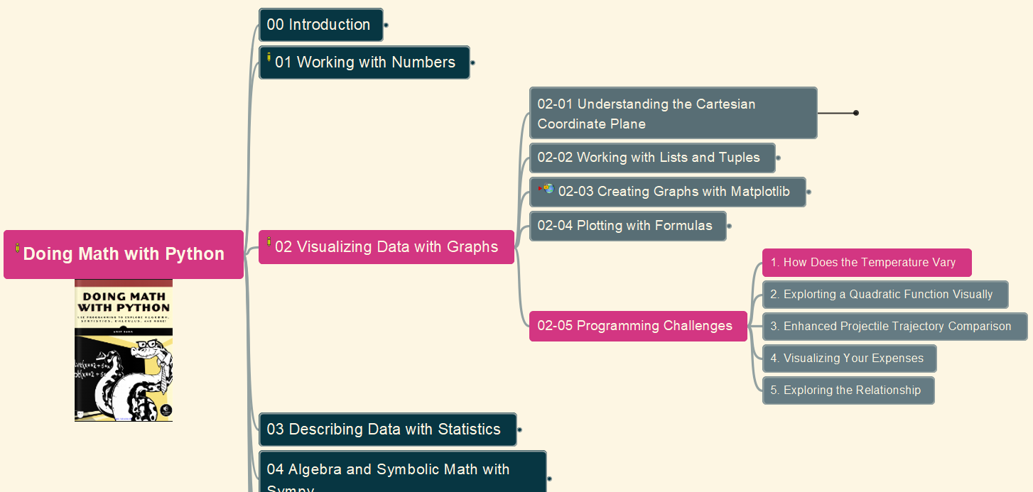
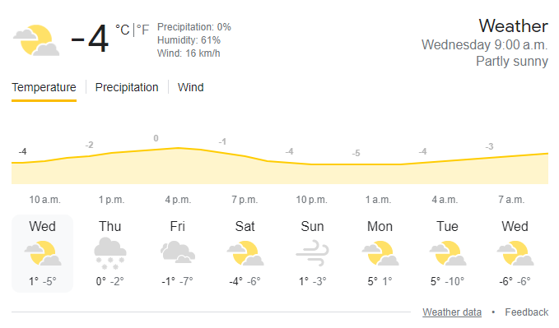
Doing Math with Python
019
Chapter 02: Visualizing Data with Graphs
02-05: Programming Challenges
(1) Vary Temperature in a Day
GitHub: https://github.com/yasenstar/DoingMathWithPython
Gitee: https://gitee.com/yasenstar/DoingMathWithPython
Yasen – Enterprise Architecture
YouTube: @yasenzhao

Slide 22
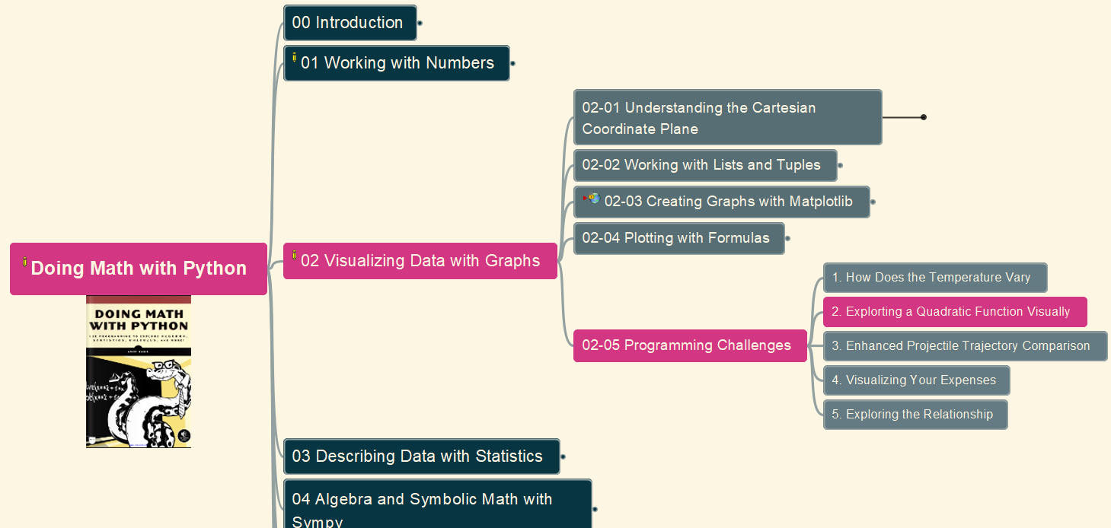
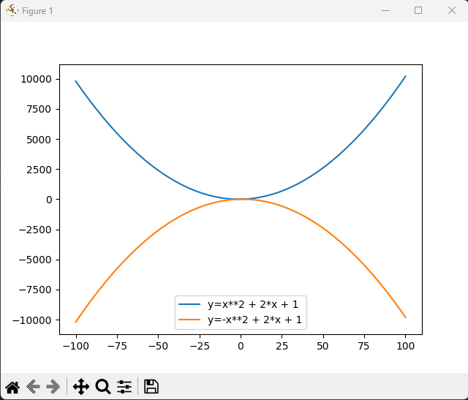
Doing Math with Python
020
Chapter 02: Visualizing Data with Graphs
02-05: Programming Challenges
(2) Visualize Quadratic Function
GitHub: https://github.com/yasenstar/DoingMathWithPython
Gitee: https://gitee.com/yasenstar/DoingMathWithPython
Yasen – Enterprise Architecture
YouTube: @yasenzhao

Slide 23
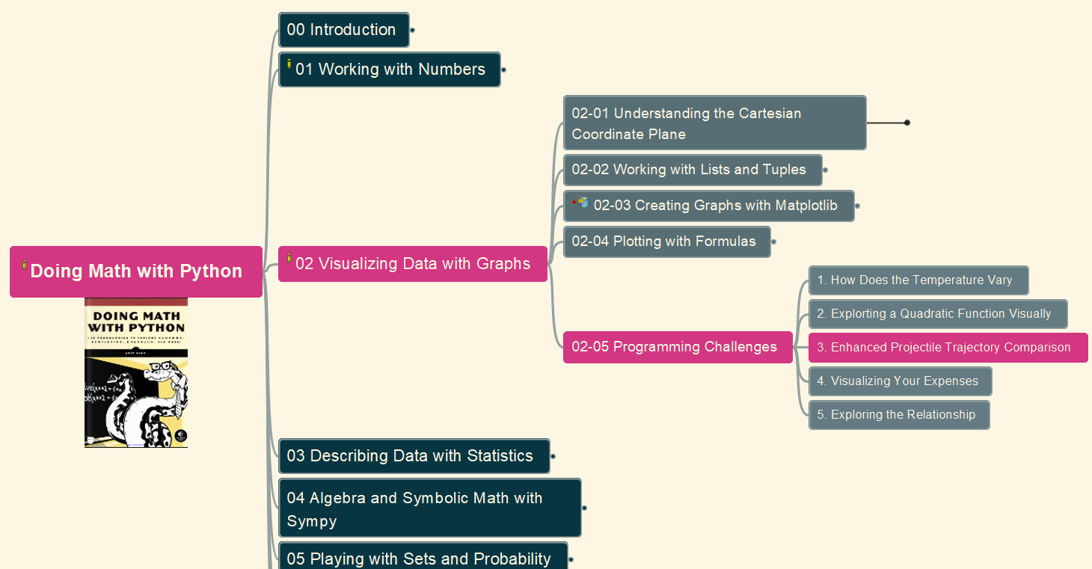
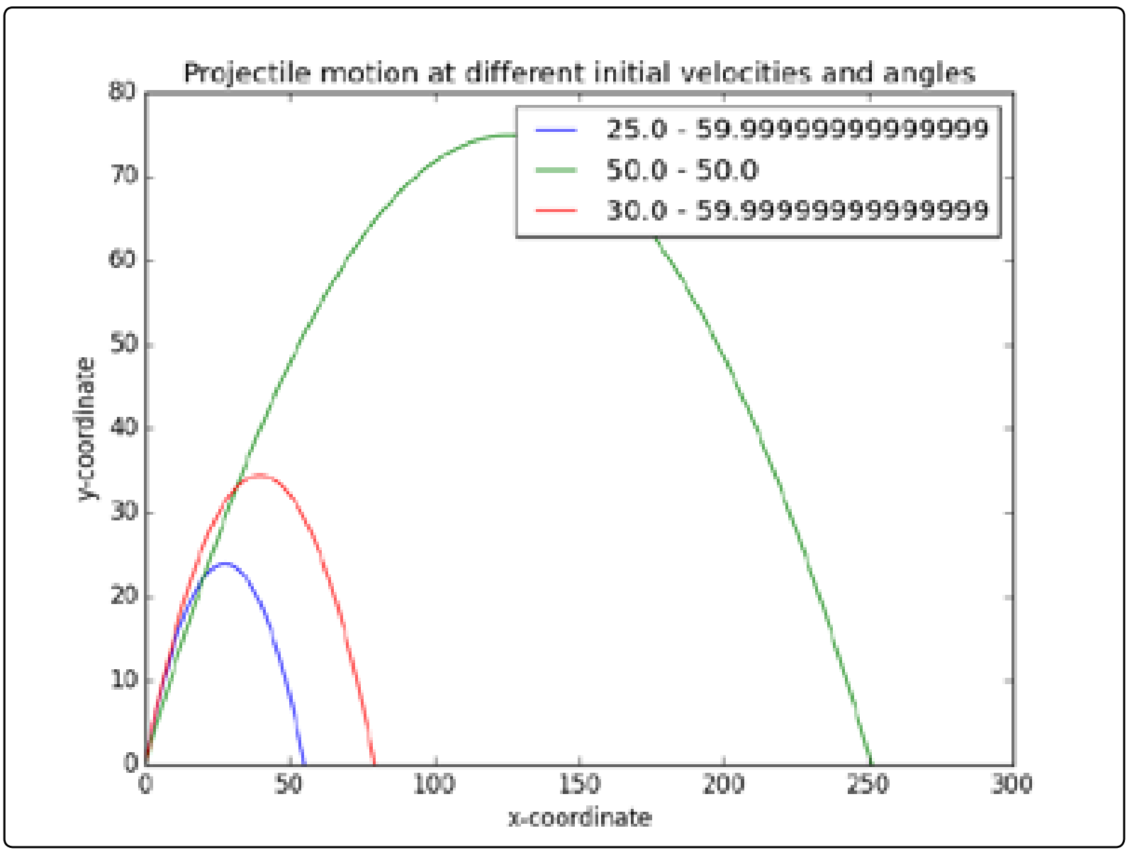
Doing Math with Python
021
Chapter 02: Visualizing Data with Graphs
02-06: Programming Challenges
(3) Enhanced Projectile Trajectory Comparison Program
GitHub: https://github.com/yasenstar/DoingMathWithPython
Gitee: https://gitee.com/yasenstar/DoingMathWithPython
Yasen – Enterprise Architecture
YouTube: @yasenzhao

Slide 24
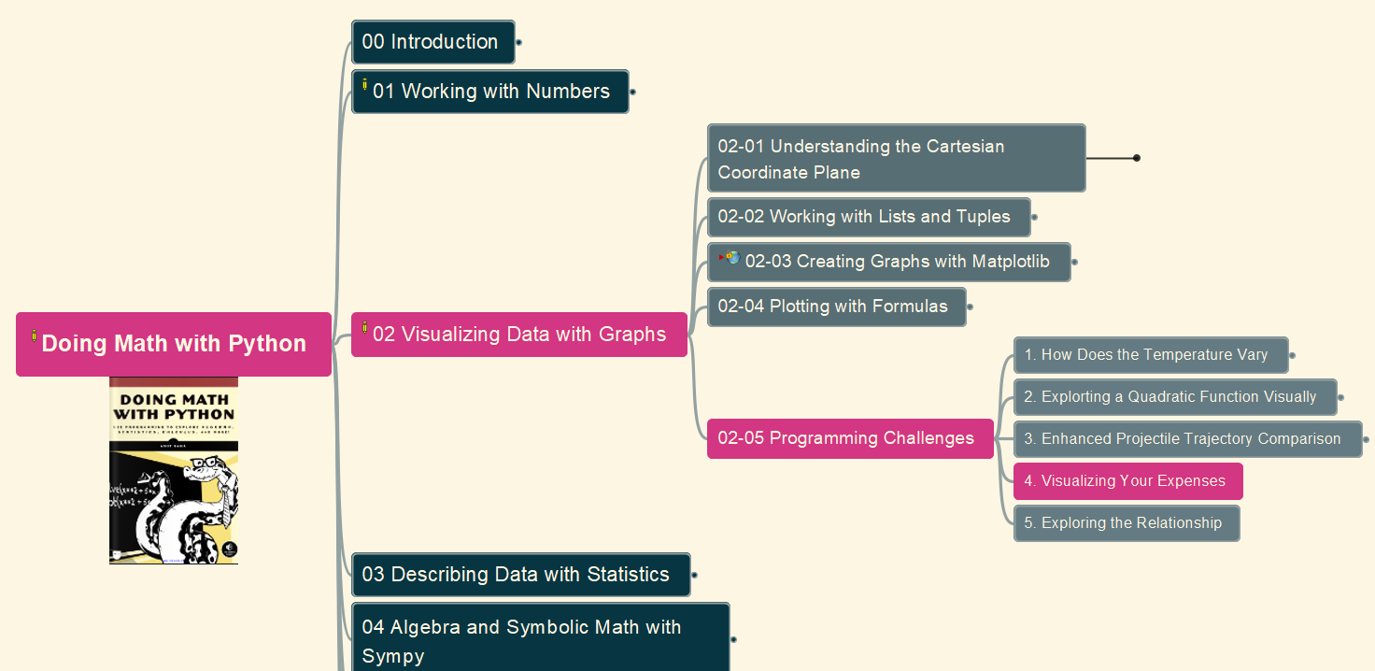
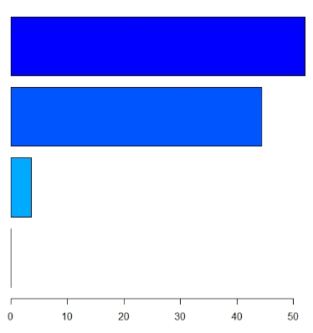
Doing Math with Python
022
Chapter 02: Visualizing Data with Graphs
02-05: Programming Challenges
(4) Visualizing Your Expenses
GitHub: https://github.com/yasenstar/DoingMathWithPython
Gitee: https://gitee.com/yasenstar/DoingMathWithPython
Yasen – Enterprise Architecture
YouTube: @yasenzhao

Slide 25
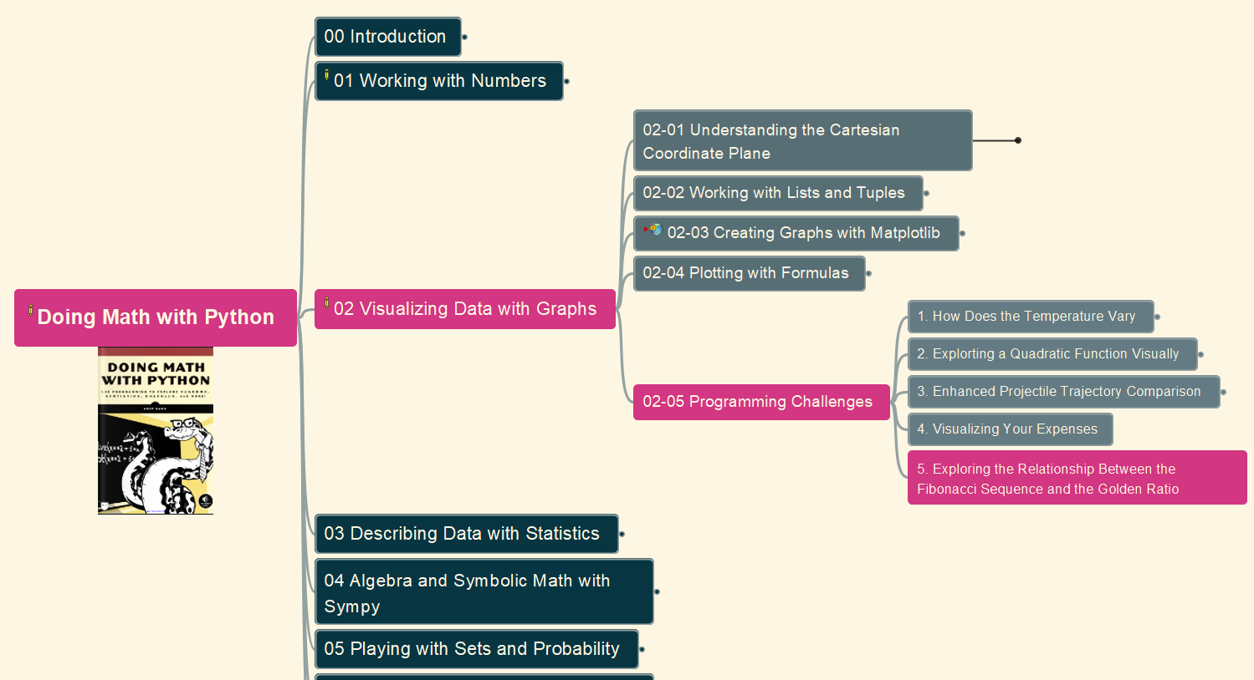
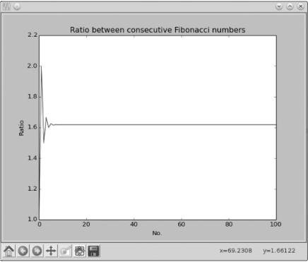
Doing Math with Python
023
Chapter 02: Visualizing Data with Graphs
02-05: Programming Challenges
(5) Relationship between Fibonacci Sequence and the Golden Ratio
GitHub: https://github.com/yasenstar/DoingMathWithPython
Gitee: https://gitee.com/yasenstar/DoingMathWithPython
Yasen – Enterprise Architecture
YouTube: @yasenzhao

Slide 26
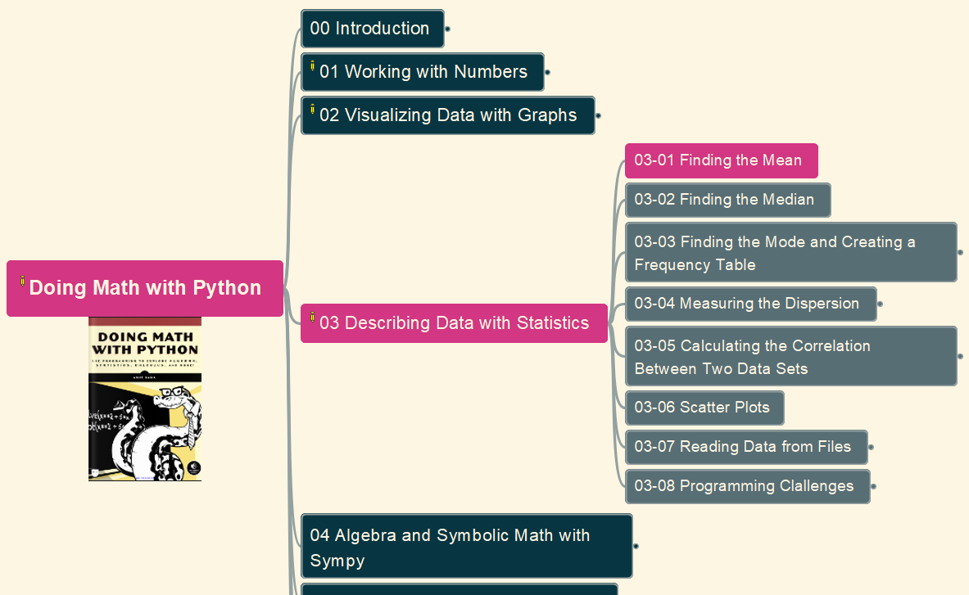
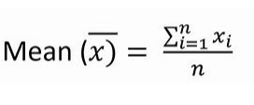
Doing Math with Python
024
Chapter 03: Describing Data with Statistics
03-01: Find the Mean
GitHub: https://github.com/yasenstar/DoingMathWithPython
Gitee: https://gitee.com/yasenstar/DoingMathWithPython
Yasen – Enterprise Architecture
YouTube: @yasenzhao

Slide 27
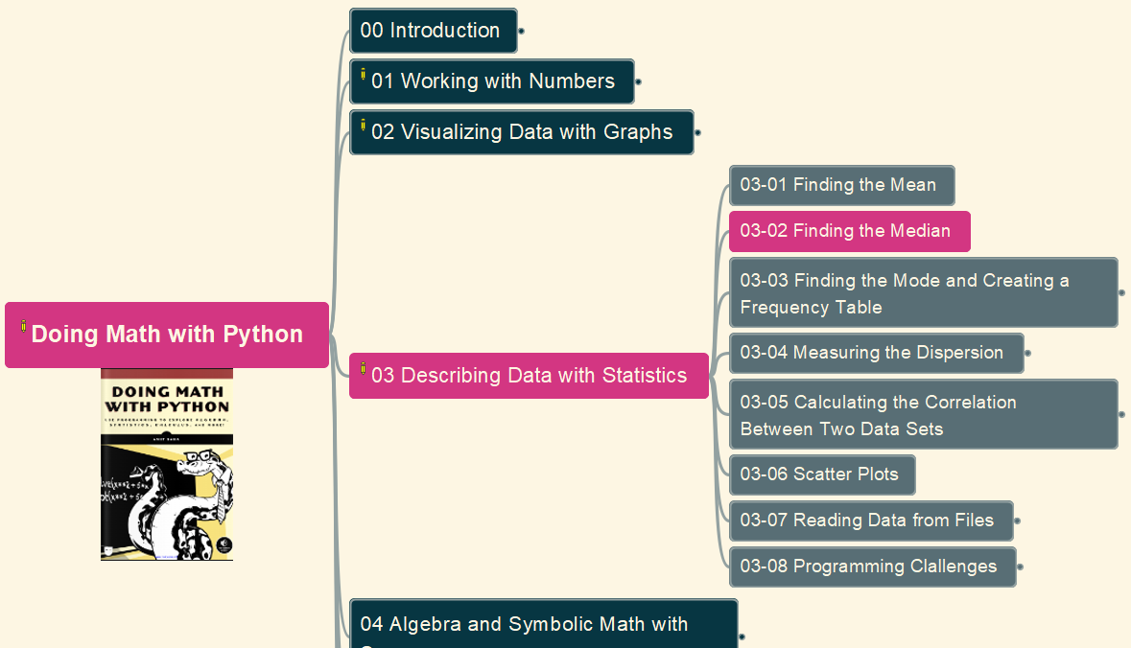
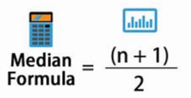
Doing Math with Python
025
Chapter 03: Describing Data with Statistics
03-02: Find the Median
GitHub: https://github.com/yasenstar/DoingMathWithPython
Gitee: https://gitee.com/yasenstar/DoingMathWithPython
Yasen – Enterprise Architecture
YouTube: @yasenzhao

Slide 28
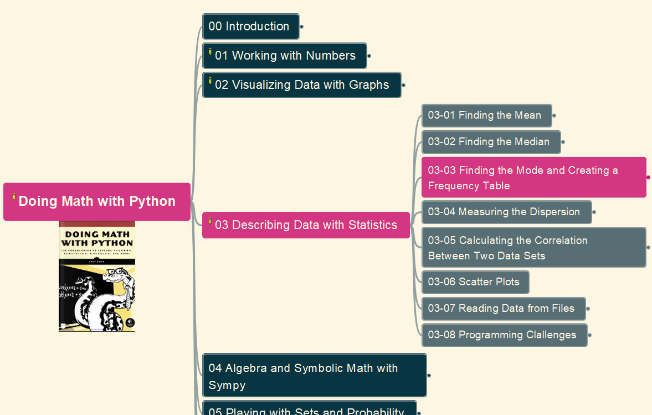
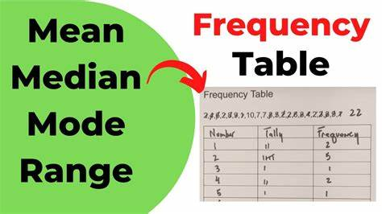
Doing Math with Python
026
Chapter 03: Describing Data with Statistics
03-03 Finding the Mode and Creating a Frequency Table
GitHub: https://github.com/yasenstar/DoingMathWithPython
Gitee: https://gitee.com/yasenstar/DoingMathWithPython
Yasen – Enterprise Architecture
YouTube: @yasenzhao

Slide 29
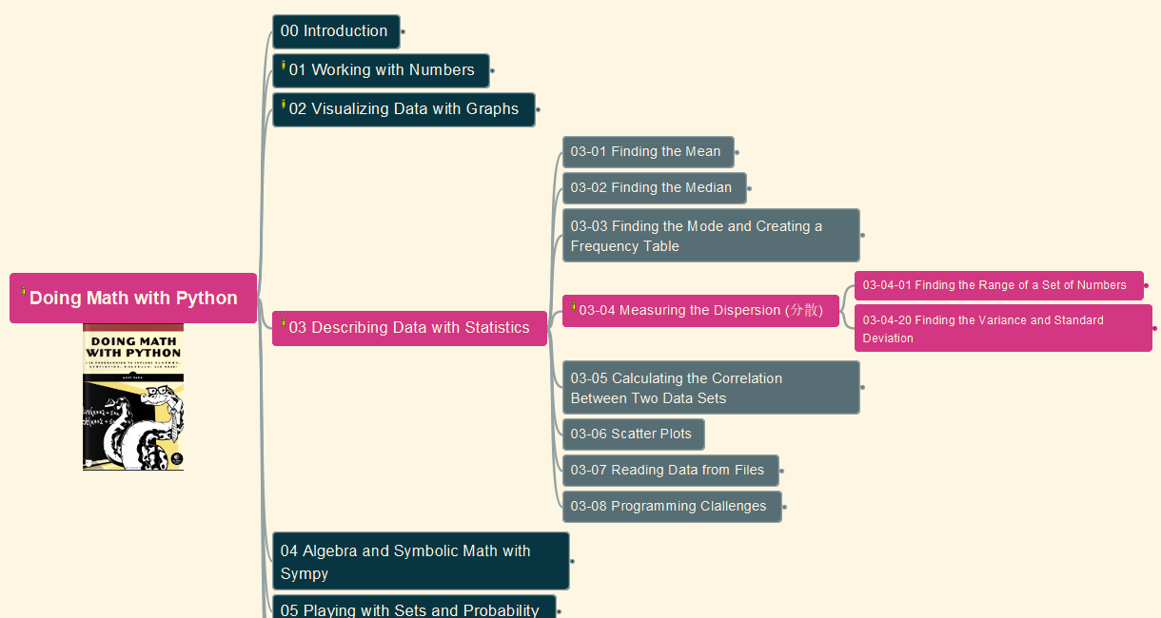
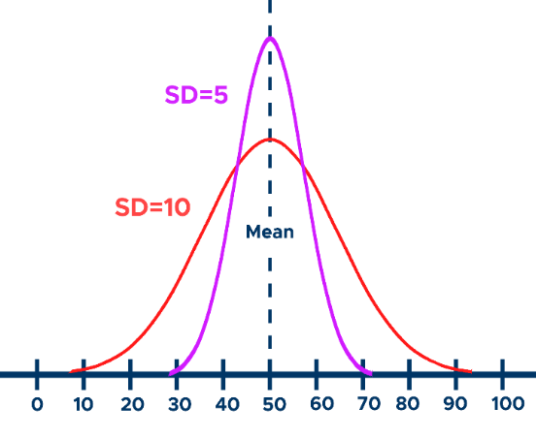
Doing Math with Python
027
Chapter 03: Describing Data with Statistics
03-04 Measuring the Dispersion
GitHub: https://github.com/yasenstar/DoingMathWithPython
Gitee: https://gitee.com/yasenstar/DoingMathWithPython
Yasen – Enterprise Architecture
YouTube: @yasenzhao

Slide 30
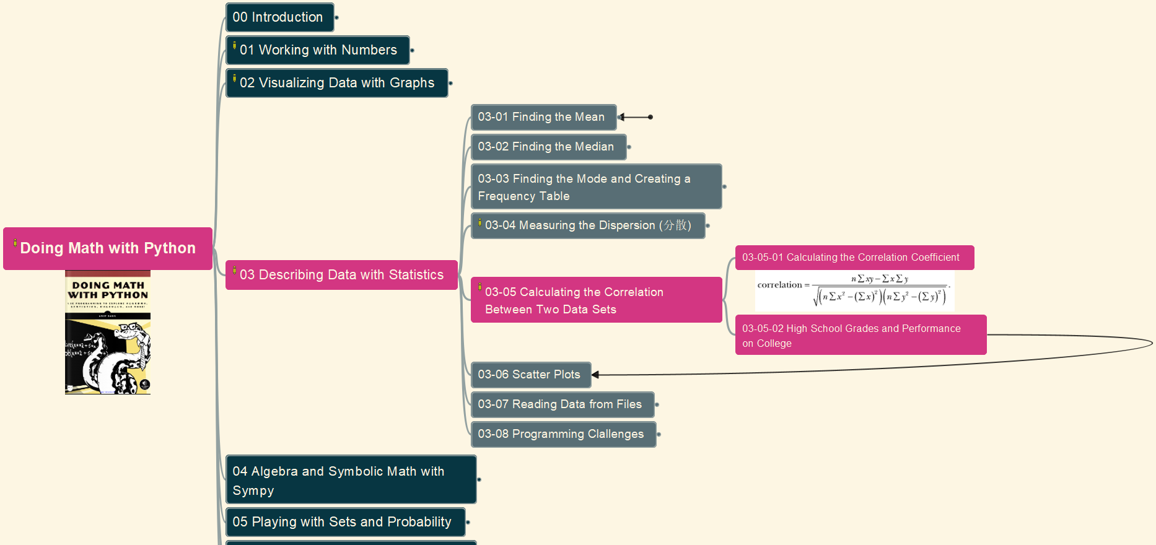
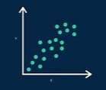
Doing Math with Python
028
Chapter 03: Describing Data with Statistics
03-05 Calculate the Correlation Between Two Data Sets
GitHub: https://github.com/yasenstar/DoingMathWithPython
Gitee: https://gitee.com/yasenstar/DoingMathWithPython
Yasen – Enterprise Architecture
YouTube: @yasenzhao

Slide 31
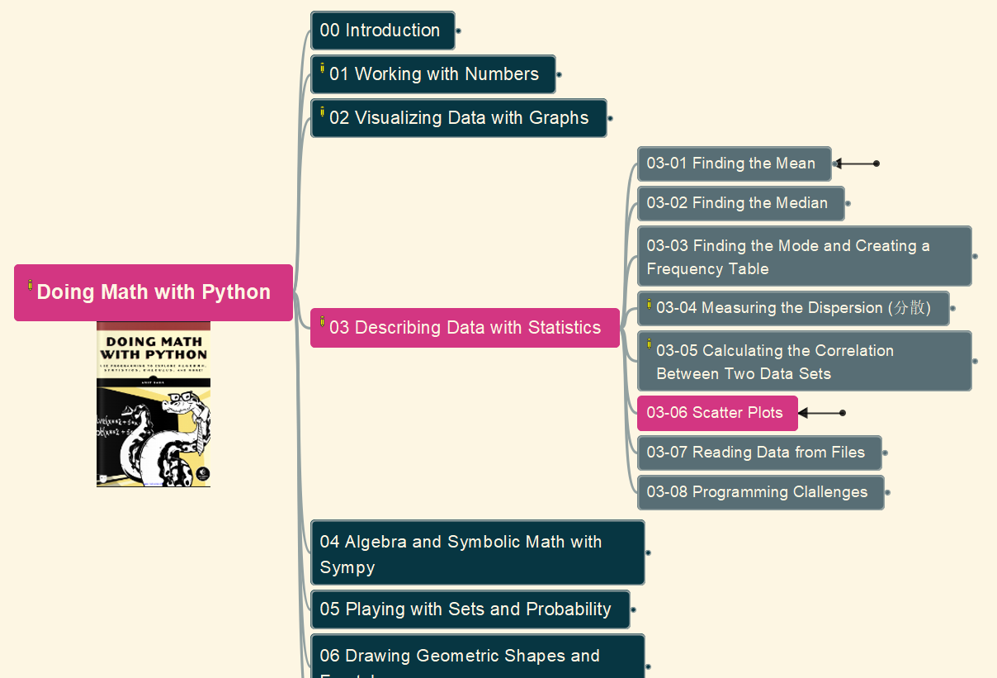
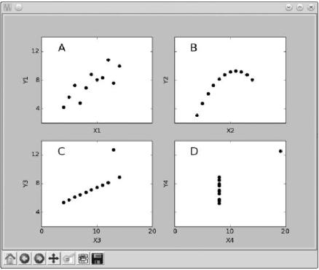
Doing Math with Python
029
Chapter 03: Describing Data with Statistics
03-06 Scatter Plots
GitHub: https://github.com/yasenstar/DoingMathWithPython
Gitee: https://gitee.com/yasenstar/DoingMathWithPython
Yasen – Enterprise Architecture
YouTube: @yasenzhao

Slide 32
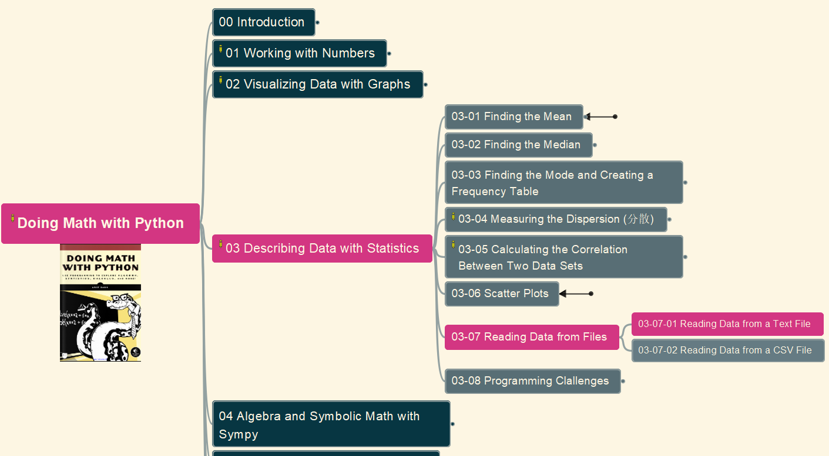

Doing Math with Python
030
Chapter 03: Describing Data with Statistics
03-07 Reading Data from Files
(1) Text File
GitHub: https://github.com/yasenstar/DoingMathWithPython
Gitee: https://gitee.com/yasenstar/DoingMathWithPython
Yasen – Enterprise Architecture
YouTube: @yasenzhao

Slide 33


Doing Math with Python
031
Chapter 03: Describing Data with Statistics
03-07 Reading Data from Files
(2) CSV File
GitHub: https://github.com/yasenstar/DoingMathWithPython
Gitee: https://gitee.com/yasenstar/DoingMathWithPython
Yasen – Enterprise Architecture
YouTube: @yasenzhao

Slide 34

Doing Math with Python
032
Chapter 03: Describing Data with Statistics
03-08 Programming Challenges
#1. Better Correlation Coefficient-Finding Program
GitHub: https://github.com/yasenstar/DoingMathWithPython
Gitee: https://gitee.com/yasenstar/DoingMathWithPython
Yasen – Enterprise Architecture
YouTube: @yasenzhao

Slide 35

Doing Math with Python
033
Chapter 03: Describing Data with Statistics
03-08 Programming Challenges
#2. Statistics Calculator
GitHub: https://github.com/yasenstar/DoingMathWithPython
Gitee: https://gitee.com/yasenstar/DoingMathWithPython
Yasen – Enterprise Architecture
YouTube: @yasenzhao

Slide 36

Doing Math with Python
034
Chapter 03: Describing Data with Statistics
03-08 Programming Challenges
#3. Experiment with Other CSV Data
GitHub: https://github.com/yasenstar/DoingMathWithPython
Gitee: https://gitee.com/yasenstar/DoingMathWithPython
Yasen – Enterprise Architecture
YouTube: @yasenzhao

Slide 37


Doing Math with Python
035
Chapter 03: Describing Data with Statistics
03-08 Programming Challenges
#4. Finding the Percentile
GitHub: https://github.com/yasenstar/DoingMathWithPython
Gitee: https://gitee.com/yasenstar/DoingMathWithPython
Yasen – Enterprise Architecture
YouTube: @yasenzhao

Slide 38
Doing Math with Python
036
Chapter 03: Describing Data with Statistics
03-08 Programming Challenges
#4. Finding the Percentile (cont.)
GitHub: https://github.com/yasenstar/DoingMathWithPython
Gitee: https://gitee.com/yasenstar/DoingMathWithPython
Yasen – Enterprise Architecture
YouTube: @yasenzhao

Slide 39

Doing Math with Python
037
Chapter 03: Describing Data with Statistics
03-08 Programming Challenges
#5. Generate a Grouped Frequency Table
GitHub: https://github.com/yasenstar/DoingMathWithPython
Gitee: https://gitee.com/yasenstar/DoingMathWithPython
Yasen – Enterprise Architecture
YouTube: @yasenzhao

Slide 40


Doing Math with Python
038
Chapter 04: Algebra and Symbolic Math with SymPy
04-00 Installing and Configuring SymPy
GitHub: https://github.com/yasenstar/DoingMathWithPython
Gitee: https://gitee.com/yasenstar/DoingMathWithPython
Yasen – Enterprise Architecture
YouTube: @yasenzhao

Slide 41

Doing Math with Python
039
Chapter 04: Algebra and Symbolic Math with SymPy
04-01 Defining Symbols and Symbolic Operations
GitHub: https://github.com/yasenstar/DoingMathWithPython
Gitee: https://gitee.com/yasenstar/DoingMathWithPython
Yasen – Enterprise Architecture
YouTube: @yasenzhao

Slide 42

Doing Math with Python
040
Chapter 04: Algebra and Symbolic Math with SymPy
04-02 Working with Expressions
GitHub: https://github.com/yasenstar/DoingMathWithPython
Gitee: https://gitee.com/yasenstar/DoingMathWithPython
Yasen – Enterprise Architecture
YouTube: @yasenzhao

Slide 43

Doing Math with Python
041
Chapter 04: Algebra and Symbolic Math with SymPy
04-03 Solving Equations
GitHub: https://github.com/yasenstar/DoingMathWithPython
Gitee: https://gitee.com/yasenstar/DoingMathWithPython
Yasen – Enterprise Architecture
YouTube: @yasenzhao

Slide 44

Doing Math with Python
042
Chapter 04: Algebra and Symbolic Math with SymPy
04-04 Plotting Using SymPy
GitHub: https://github.com/yasenstar/DoingMathWithPython
Gitee: https://gitee.com/yasenstar/DoingMathWithPython
Yasen – Enterprise Architecture
YouTube: @yasenzhao

Slide 45

Doing Math with Python
043
Chapter 04: Algebra and Symbolic Math with SymPy
04-04 Programming Challenges
(1) Factor Finder
GitHub: https://github.com/yasenstar/DoingMathWithPython
Gitee: https://gitee.com/yasenstar/DoingMathWithPython
Yasen – Enterprise Architecture
YouTube: @yasenzhao

Slide 46

Doing Math with Python
044
Chapter 04: Algebra and Symbolic Math with SymPy
04-04 Programming Challenges
(2) Graphical Equation Solver
GitHub: https://github.com/yasenstar/DoingMathWithPython
Gitee: https://gitee.com/yasenstar/DoingMathWithPython
Yasen – Enterprise Architecture
YouTube: @yasenzhao

Slide 47

Doing Math with Python
045
Chapter 04: Algebra and Symbolic Math with SymPy
04-04 Programming Challenges
(3) Summing a Series
GitHub: https://github.com/yasenstar/DoingMathWithPython
Gitee: https://gitee.com/yasenstar/DoingMathWithPython
Yasen – Enterprise Architecture
YouTube: @yasenzhao

Slide 48

Doing Math with Python
046
Chapter 04: Algebra and Symbolic Math with SymPy
04-04 Programming Challenges
(4) Solving Single-Variable Inequalities
GitHub: https://github.com/yasenstar/DoingMathWithPython
Gitee: https://gitee.com/yasenstar/DoingMathWithPython
Yasen – Enterprise Architecture
YouTube: @yasenzhao

